Slide 1
Diagnosing Connectivity Issues with SQL Server
Evan Basalik
Escalation Engineer
Microsoft
evanba@microsoft.com

Slide 2
Agenda
Connectivity Errors
Tools
Common problems
Demonstrations
Questions

Slide 3
Connectivity Errors
General Network Error (GNE)
SQL Server not found or Access Denied
Login failed for user ‘null’
A network-related or instance-specific error occurred while establishing a connection to SQL Server. The server was not found or was not accessible. Verify that the instance name is correct and that SQL Server is configured to allow remote connections. (provider: TCP Provider, error: 0 - No such host is known.)
Connection reset

Slide 4
Login failed for user ‘null’
99% of the time, this is an indication Kerberos is not properly configured
99% of the time just add these four SPNs
MSSQLSVC/FQDN
MSSQLSVC/NetBIOS
MSSQLSVC/FQDN:port
MSSQLSVC/NetBIOS:port
If that doesn’t work, search for duplicates (setspn –x)
The other 1% of 1% - not going to be fun ☹

Slide 5
Tools
Universal Data Link (UDL) - http://msdn.microsoft.com/en-us/library/e38h511e(VS.71).aspx
Ping (and “-a”)
PortQueryUI
Dedicated Admin Connection (DAC)
Netmon

Slide 6
Ping
Simple and easy
Confirms the server exists on the network
If you use the –a option, you can also confirm that a reverse lookup works
Ping –a IP
Ping –a servername

Slide 7
UDL
Probably the most important tool for the vast majority of connectivity cases
Checks all three protocols (TCP, named pipes, shared memory)
Checks name resolution (NetBIOS vs. FQDN vs IP)
Checks SQL Browser (named instances)
tcp:NetBIOS
tcp:NetBIOS,port
tcp:FQDN
tcp:FQDN,port
tcp:IP
tcp:IP,port
np:NetBIOS
np:NetBIOS,port
np:FQDN
np:FQDN,port
np:IP
np:IP,port
lpr:NetBIOS
lpr:NetBIOS,port
lpr:FQDN
lpr:FQDN,port
lpr:IP
lpr:IP,port
Notes:
Demo
Point out protocols need to be lowercase

Slide 8
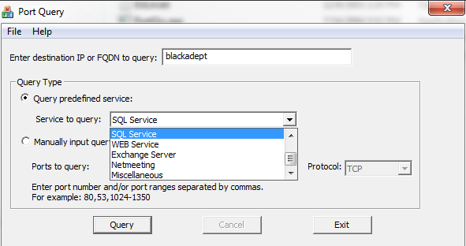
PortQuery UI
http://www.microsoft.com/downloads/details.aspx?familyid=8355e537-1ea6-4569-aabb-f248f4bd91d0&displaylang=en
Notes:
PortQuery demo

Slide 9
Dedicated Admin Connection (DAC)
Rules out server-side performance issues like scheduler hangs since this endpoint has a dedicated thread
Prefix servername with ADMIN: or admin:
Can only be used by sysadmins
Must have SQL Browser enabled

Slide 10
Netmon
HUGE usability upgrade in 3.x
Easier filter definitions
Protocol parsers are publically available (installed by default)
Command-line capture/parsing tool (NMCap)
Chained files (ever try to parse a 1 GB trace file?)
No reboot necessary to install and capture
Parsers are customizable
Notes:
NMCap /network * /capture /file test.chn:25M

Slide 11
RESETs
A RESET in a SQL Server trace is *always* bad
Although theoretically possible, I have never seen SQL Server connectivity libraries (SQLClient, SQL Server Native Client, WDAC, MDAC) cause a RESET at the TCP layer once you are connected (with the exception of a KILLed SPID).
One of first things I do in most traces is look for RESETs (tcp.flags.reset==1)
TCP Chimney is known to cause resets
With a modern driver and KB 950224 this shouldn’t be a problem

Slide 12
Please upgrade your drivers!!!!

Slide 13
Demonstrations
The Errorlog is your friend
Traceflag 4029 is your best friend
Where did all the time go?
Capturing a trace
Capturing a trace to a named instance
Modifying the parsers
SQL Browser failure
SQL Azure
Notes:
See slides
Default Instance.cap
Named Instance.cap
Named Instance.cap
UDP_XXXXX.cap
Client.cap/server.cap
SQL Azure.cap

Slide 14
Demonstration 1 - Where did all the time go?
Client applications reporting ~5s delays for *all* queries
Profiler trace shows that queries are executing fast

Slide 15
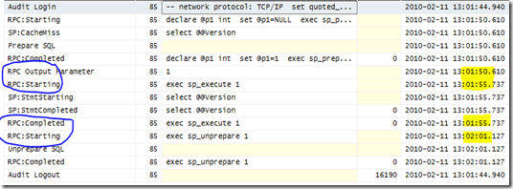
Where did all the time go? (b)

Slide 16
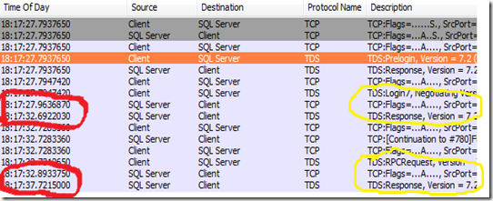
Where did all the time go? (c)

Slide 17
Demonstrations
Where did all the time go?
Reading a trace
Modifying the parsers (named instances)
SQL Browser failure
Connection reset
SQL Azure
Notes:
See slides
Default Instance.cap
Named Instance.cap
UDP_XXXXX.cap
Client.cap/server.cap
SQL Azure.cap

Slide 18
Questions

Slide 19


